Slide 1
Understanding The Trends
US Presidential Elections

Slide 2
Team Menmbers
Luis Goldaracena
Leonardo Alvarado
Jordan Villalobos
Salvador Amador
Dataset Information
From: https://www.kaggle.com/
Dataset: US Elections Dataset
Dataset of Historic US Election Results

Slide 3
Extract-Transform-Load

Slide 4
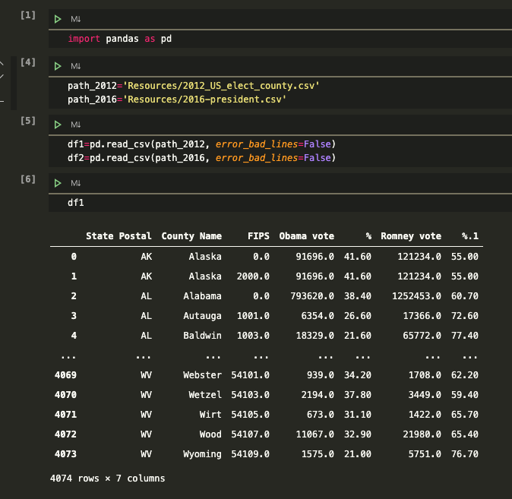
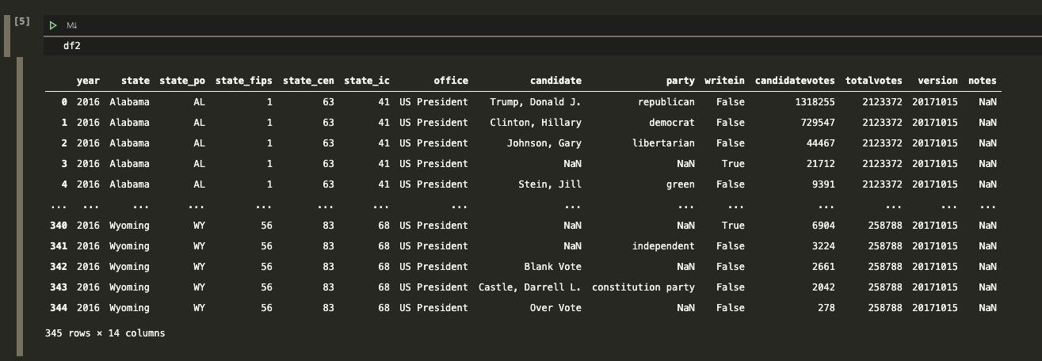
Extract
Dataframe 1 = 2012_US_elect_county.csv
Datasets
We obtained two datsets containg the information of the Presidential Elections from 2012 and 2016:
2012_US_elect_county.csv
2016-president.csv
We extract the dataset into a dataframe
Dataframe 2 = 2016-president.csv

Slide 5
Transform
Dataframe 1 = 2012_US_elect_county.csv
Datasets
From each dataframe, we selected only the columns with the information needed.
In df1 we did a drop duplicates.
Dataframe 2 = 2016-president.csv

Slide 6
Transform
Dataframe 2
Datasets
In dataframe 2 we separated the data of votes in two columns to resemble df1.
Df1 colums were renamed
Dataframe 1

Slide 7
Transform
Dataframe 2
Datasets
df2 was group by state and counted the votes for each political party.

Slide 8
Transform
Dataframe 1
Datasets
For df1 were only selected the rows where FIPS = 0, which corresponds the summary

Slide 9
Transform
Dataframe 1
Datasets
For df1 columns were renamed and selected only the ones that we need to make equal as df2.

Slide 10
Transform
Dataframe 1
Datasets
For df1 columns were renamed with lower case to load them into Postgress

Slide 11
Transform
Dataframe 1
Datasets
For df1 and df2 columns were renamed with lower case to load them into Postgress

Slide 12
Load
Datasets
Connect to Postgress
Append the data into database

Slide 13
Load
Datasets
Query the database to make sure the information was loaded

Slide 14
Load
Datasets
Postgess table schemas

Slide 15
Conclusion
The time-consuming part of the project is the data cleaning and dataframe formatting so both datasets look alike.
Afterwards the data loading is not that complicated.

